Slide 1
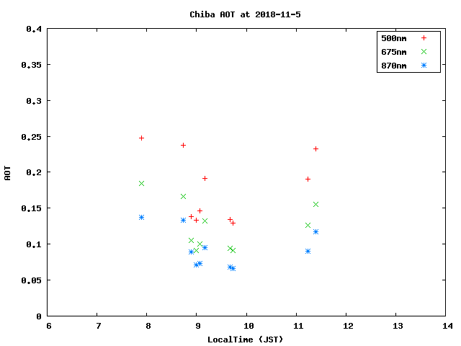
AOT plot(Data from POM skyradiometer)

Slide 2
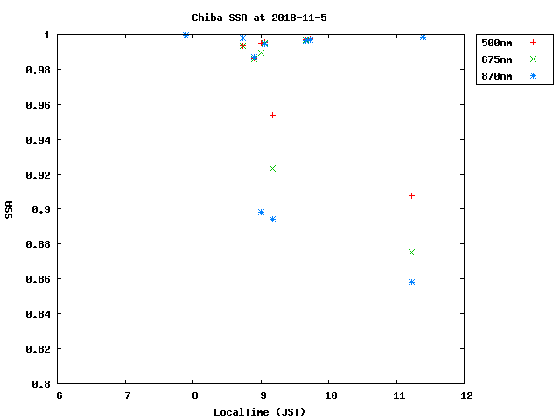
SSA plot(Data from POM skyradiometer)

